Slide 1

Session Management ASP.NET Core 6
Sit Dolor Amet

Slide 2
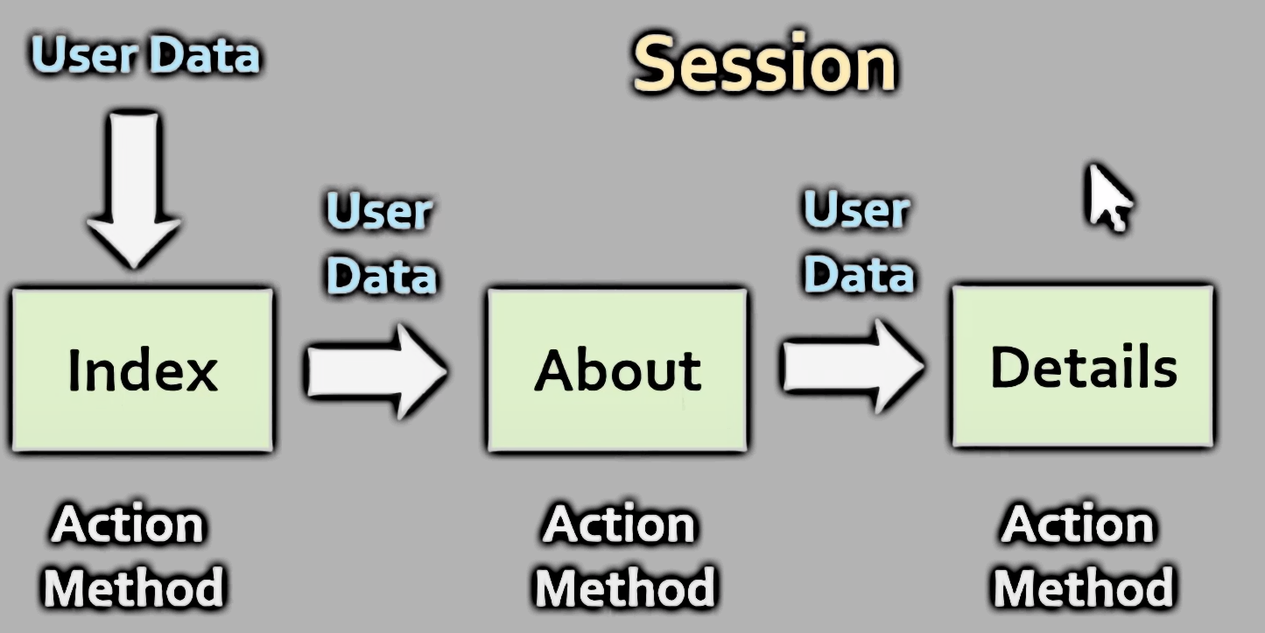
“Session management is an essential aspect of developing MVC applications, allowing you to maintain state across multiple requests”
Session

Slide 3
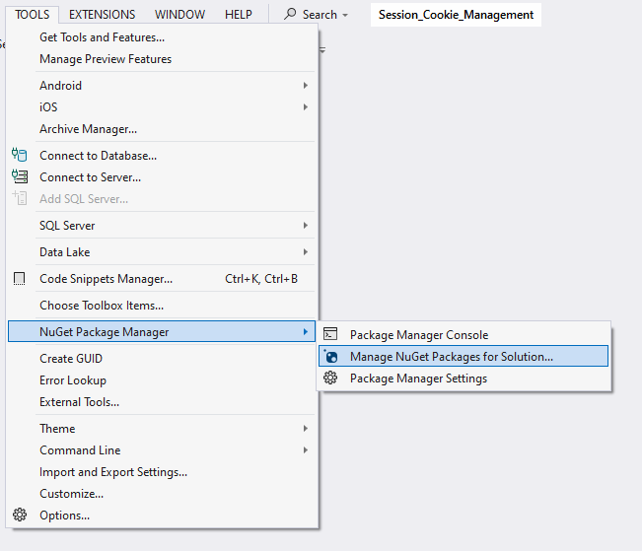

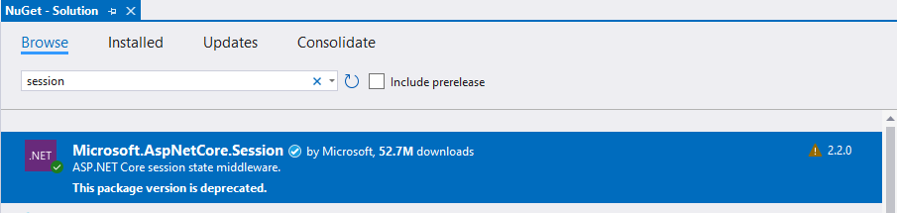

Slide 4




Add blow line before build
Program.cs
Create Session Variable
Key
Value
Access Session Variable

Slide 5

Access Session Variable
Directly in View

Slide 6
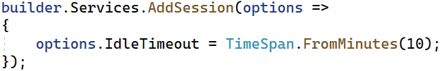
What is Session?
It is a state management technique.
Session state is an ASP.NET Core scenario for storage of user data while the user browses a web app.
Session state uses a store maintained by the app to persist data across requests from a client.
Critical application data should be stored in the user database and cached in session only as a performance optimization.
The session is specific to the browser, Session aren’t shared across browsers.
Session are deleted when the browser session end.
Sessions are Server-Side.
Session is also used to pass data within the ASP.NET Core MVC application and unlike TempData.
It persist for its expiration time (default time is 20 minutes but it can be increased or decreased).

Slide 7
What is Session?
Session is valid for all requests, not for a single redirect.
A session state stores application-specific data in key-value pairs.
A session state stores user-specific information for an ASP.NET MVC application. e.g. Facebook login detail
However, the scope of session state is limited to the current browser session.
When many user access an application simultaneously, then each of these users will have a different session state.

